Slide 1
L6d2
Cu boulder
Csci 3155: principles of programming languages
Summer 2018
Spencer wilson
07/19/18

Slide 2
PLAN
Languages
Regular expressions
BNF
Our Lab

Slide 3
Languages

Slide 4
Types of languages
There are arithmetic languages
Regular languages
Context free languages
Context Sensitive languages
There are computer languages
Object oriented
Functional
There are human languages (polymorphic, fusional, agglutinative, ??isomorphic??)

Slide 5
arithmetic languages
Regular languages
2* { 2^{n} | n >= 0 }
Context free languages
S ::= 2S3 | \epsilon { 2^{n}3^{n} | n >= 0 }
Context Sensitive languages
I forget the grammar... { 2^{n}3^{n}4^{n} | n >= 0 } I’ll have it on Monday

Slide 6
Do you think these are cool?
We actually have a course Theory of Computation
It covers
The 3 arithmetic languages
The machines that we can build with each of them
Their advantages and disadvantages
Their history (Think Allen Turing in Enigma)
Their application in the real world
The course changes a LOT based on who is teaching but it’s typically a great course.

Slide 7
Questions?
?
Languages

Slide 8
Regular expression

Slide 9
Note
In regex white space matters
But if I write the slides without white space it becomes really difficult to read
I’ve added white space for legibility. So bear this in mind when reviewing the slides

Slide 10
Regular expressions
Regular expressions are use to describe regular languages
They are really popular in programming for their ability to match patterns
How does a website know that you’ve entered
A valid phone number
A valid email
….

Slide 11
examples
a { a }
b { b }
ab { ab }
. { a, b, c, d, …,z, A, B,…, Z, 0,…9, %, $, …., <any single character>… }
a* { ‘’, a, aa, aaa, aaaa, …..}
ab.* { ab, aba, abb, abc, abd, abe, …. }

Slide 12
Generally - atoms
! No string
# empty string
. Single char
<char> exactly on of the char provided e.g.

Slide 13
General - operations
~ re not re
re ? option for re
re * 0-or-many re
re + 1-or-many re
re₁ re₂ concatenate re1 and re2 e.g. ab
re₁ | re₂ Union re1 and re2
re₁ & re₂ Intersect of re1 and re2
( re ) enforce order on re

Slide 14
Extended
Beyond the scope of our lab this also has…
Ranges [a-c] { a, b, c } [a-c, A-C] { a, b, c, A, B, C }
Repetition a{5} { aaaaa } a{2,5} { aa, aaa, aaaa, aaaaa }
much MUCH more
The syntax changes by the PL

Slide 15
Regex
Regex a concept and a programming language that has been integrated to many other languages
Its likely available in every PL that you’ve ever used
The syntax varies

Slide 16
Regex in practice
In practice you can use regex to test
partial patterns
Prefix patterns
Suffix patterns
In our lab we only allow the testing of complete patterns… you can still create the others
Partial patterns /^ .* RE .* $/
Prefix patterns /^ RE .* $/
Suffix patterns /^ .* RE $/

Slide 17
Testing regex in javascript
In true JavaScript….
/^re$/.test(v) returns true or false
/^a$/.test(“a”) true
/^a$/.test(“b”) false
/^a$/.test(“A”) false
/^.$/.test(“a”) true
/^.$/.test(“b”) true
/^.$/.test(“A”) true
/^.$/.test(“AF”) false

Slide 18
Testing regex in javascript
Recall
a { a }
/^a$/.test(“a”) true
/^a$/.test(“b”) false
/^a$/.test(“A”) false
Do you agree?

Slide 19
Testing regex in javascript
Recall
. { a, b, c, d, …,z, A, B,…, Z, 0,…9, %, $, …., <any single character>… }
/^ . $/.test(“a”) true
/^ . $/.test(“b”) true
/^ . $/.test(“A”) true
/^ . $/.test(“AB”) false
Do you agree?

Slide 20
Test
In Lab 6 you need to implement a function named text
It takes in a RegExpr
RegExpr is an AST that we create over our subset of RegEx that we are interested in
It also takes in a List[Char]
Essentially a string
It tests, does the List[Char] exist in the language described by the RegExpr
An Operational Semantic: re.test(s) = b
You could* write inference rules if you wanted… they might help you, they might not

Slide 21
Questions?
?
Regular languages, Regualr Expressions, RegEx, RegExpr
NOTE: those are all different things

Slide 22
BNF
Projector….

Slide 23
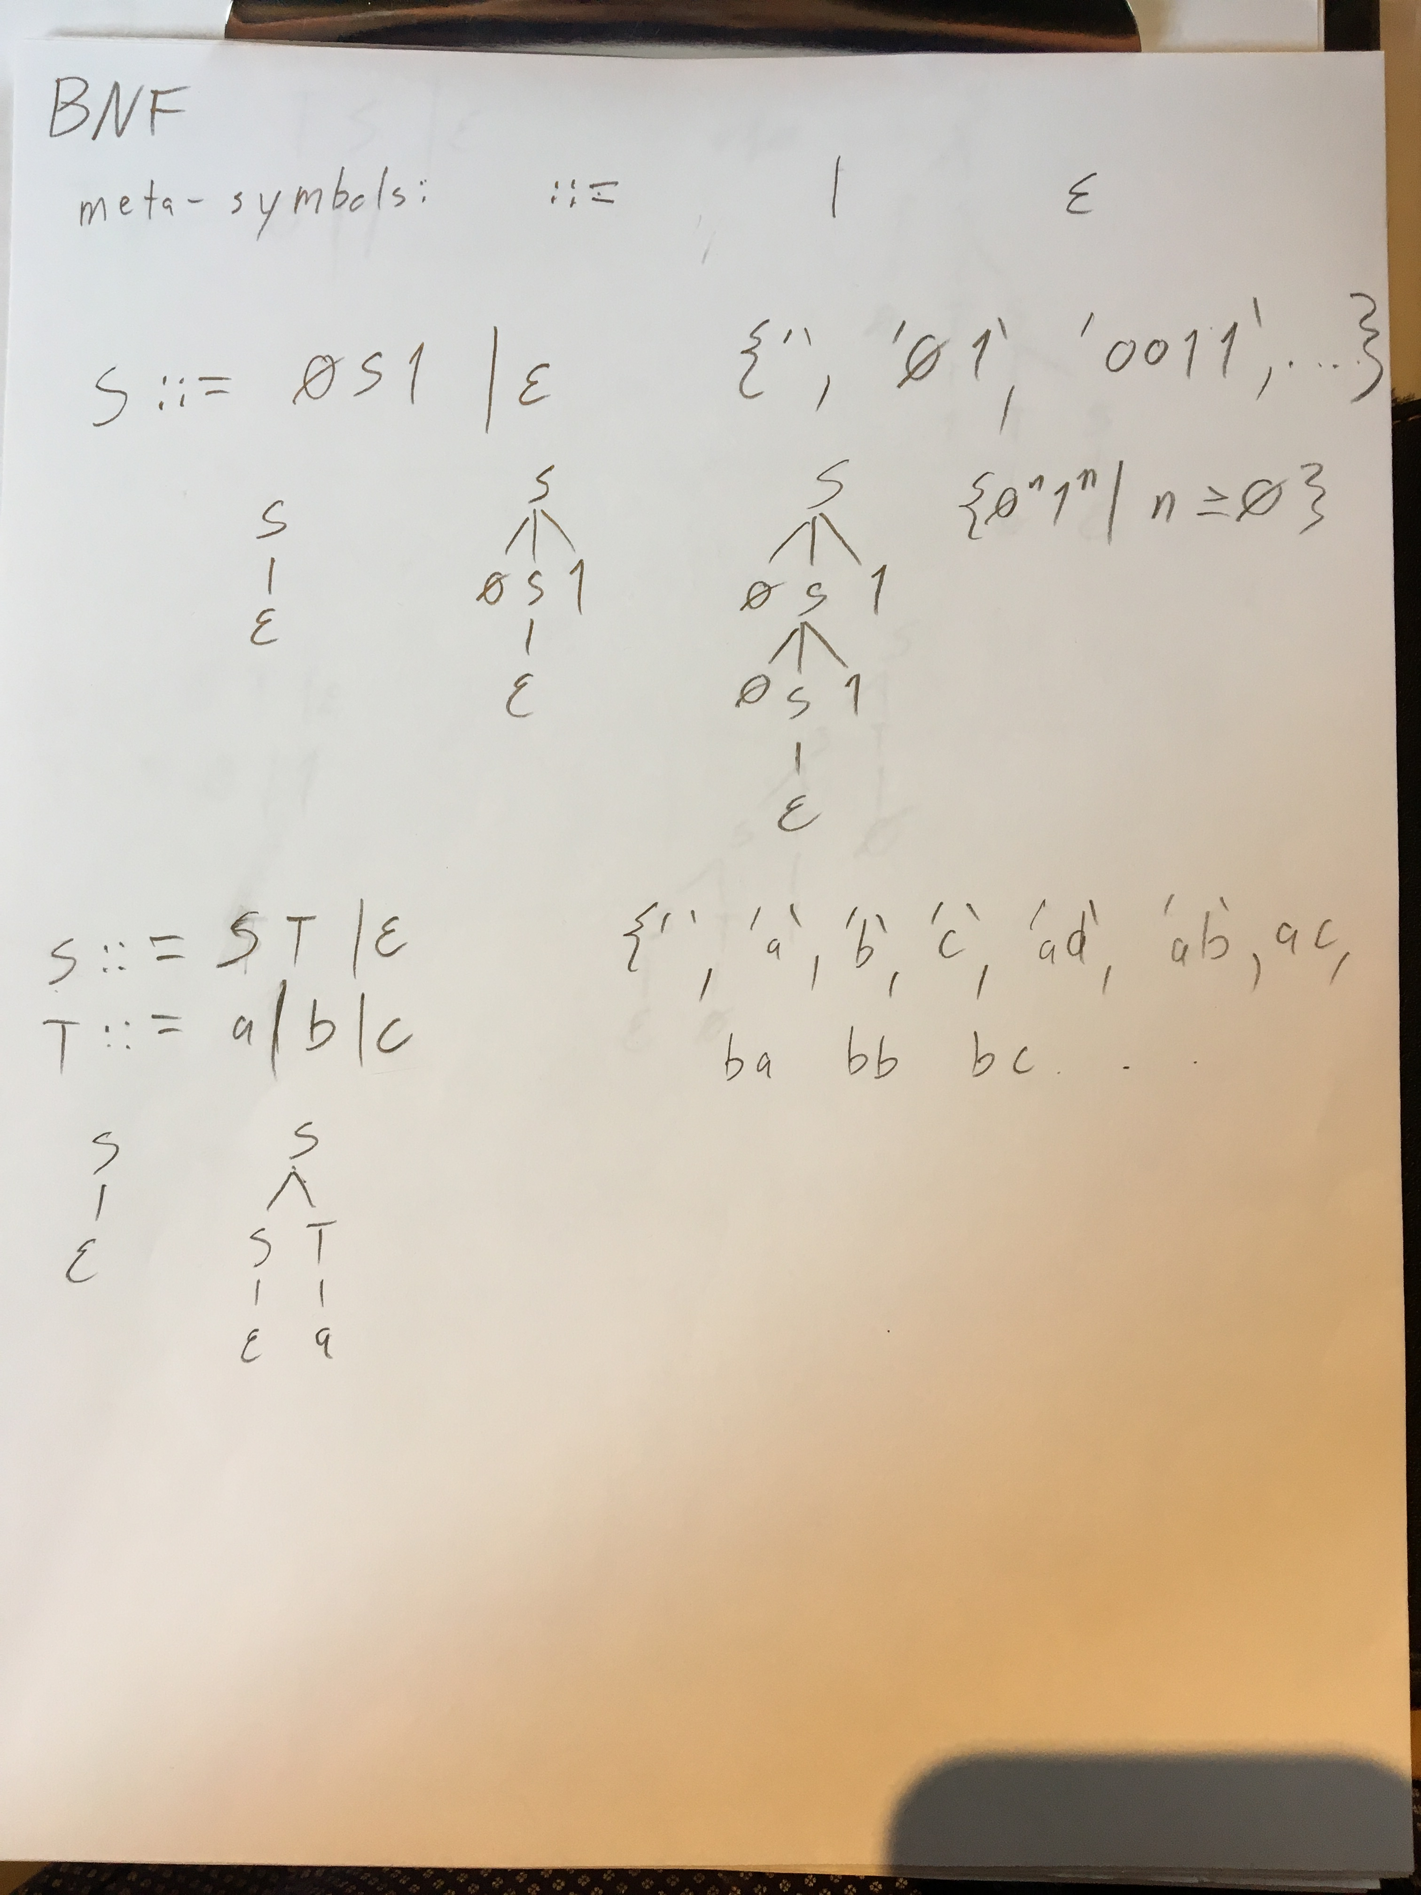
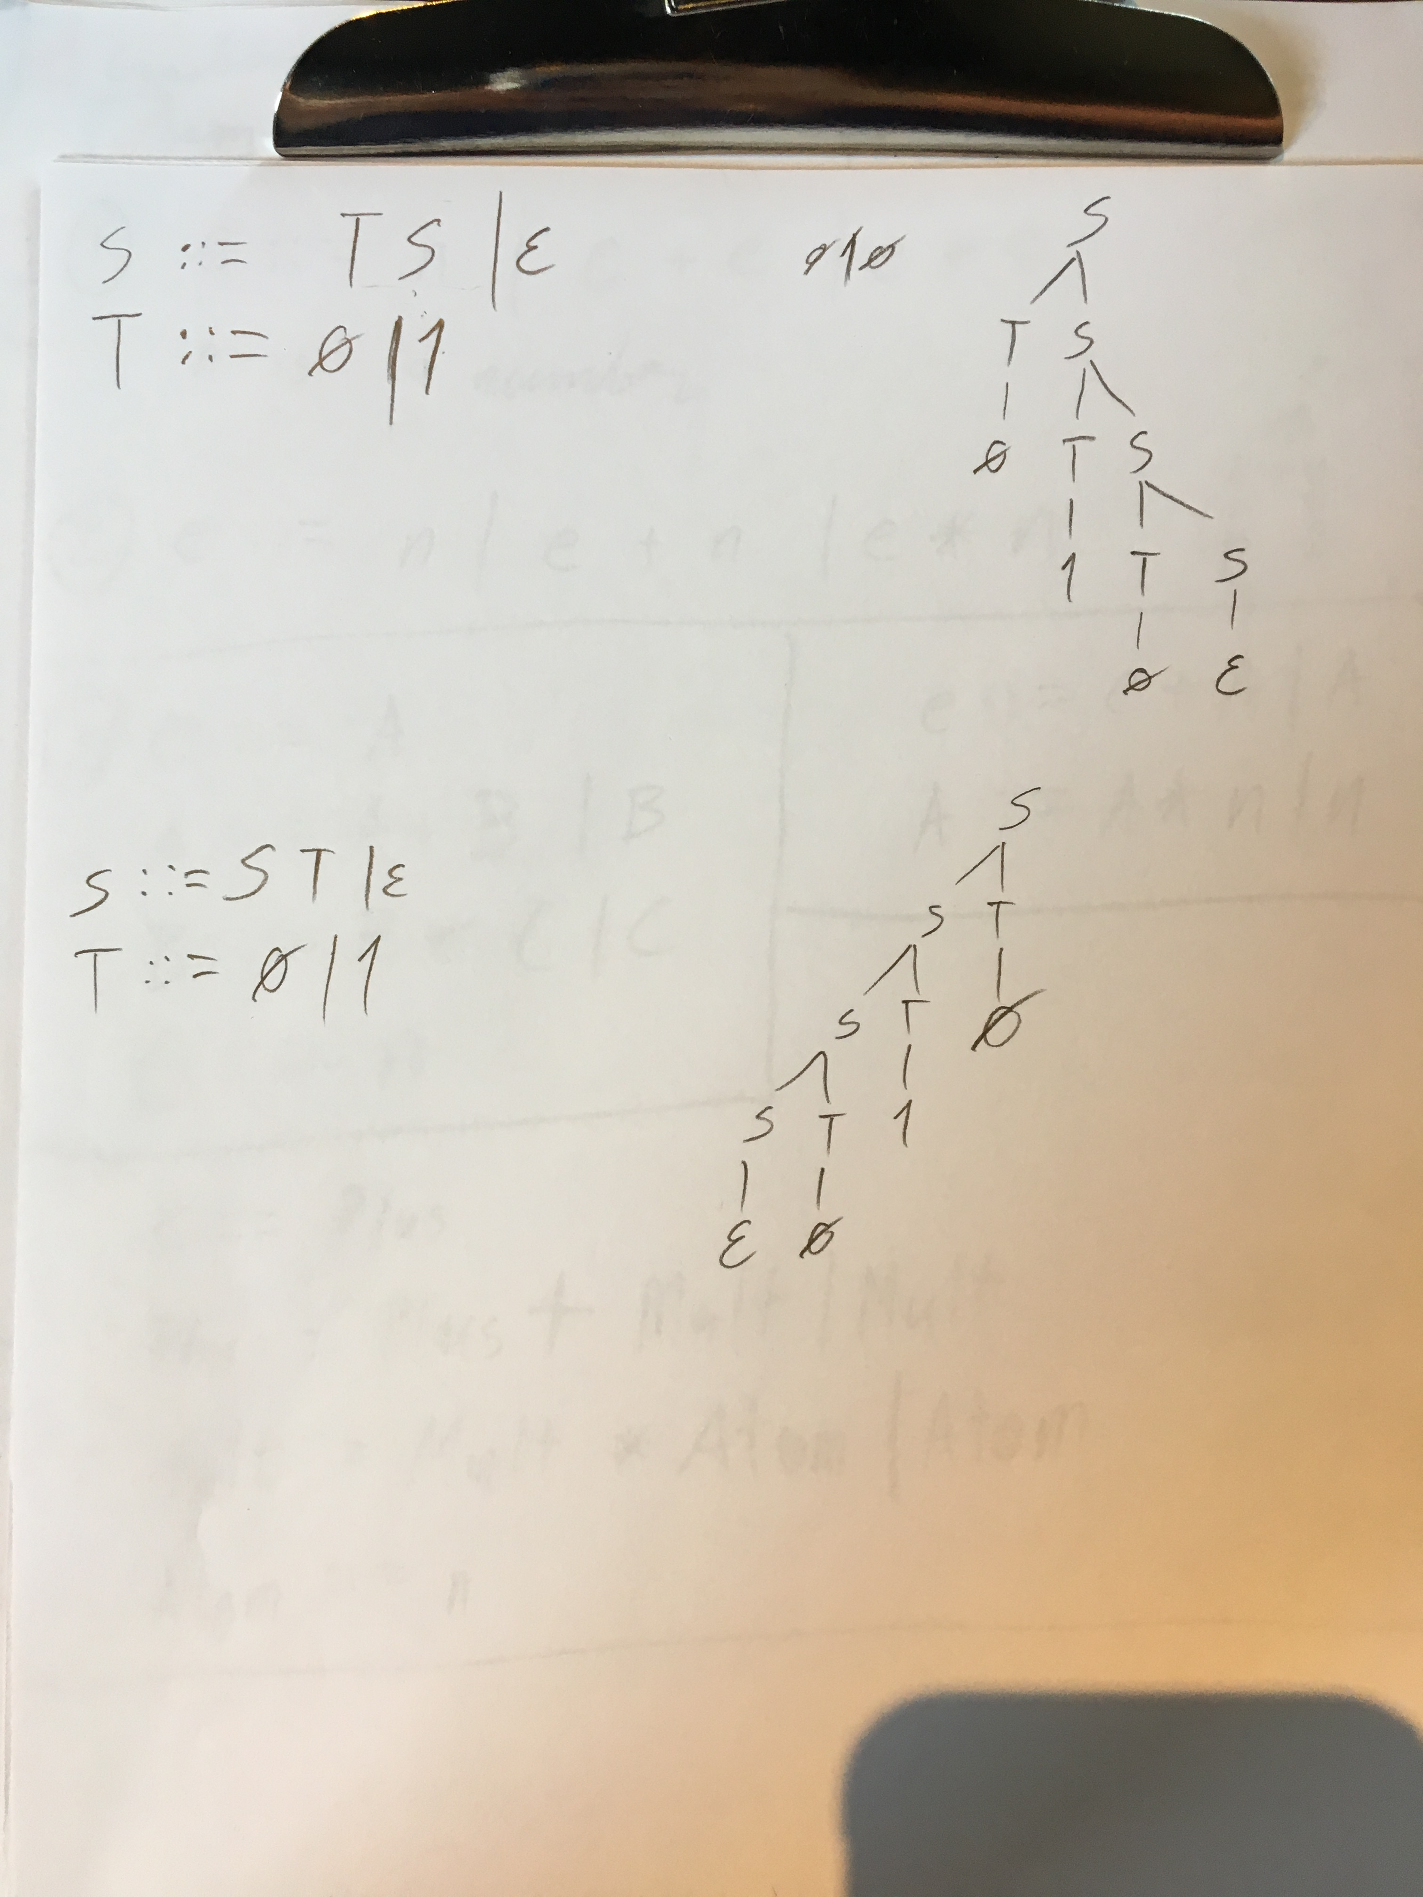

Slide 24
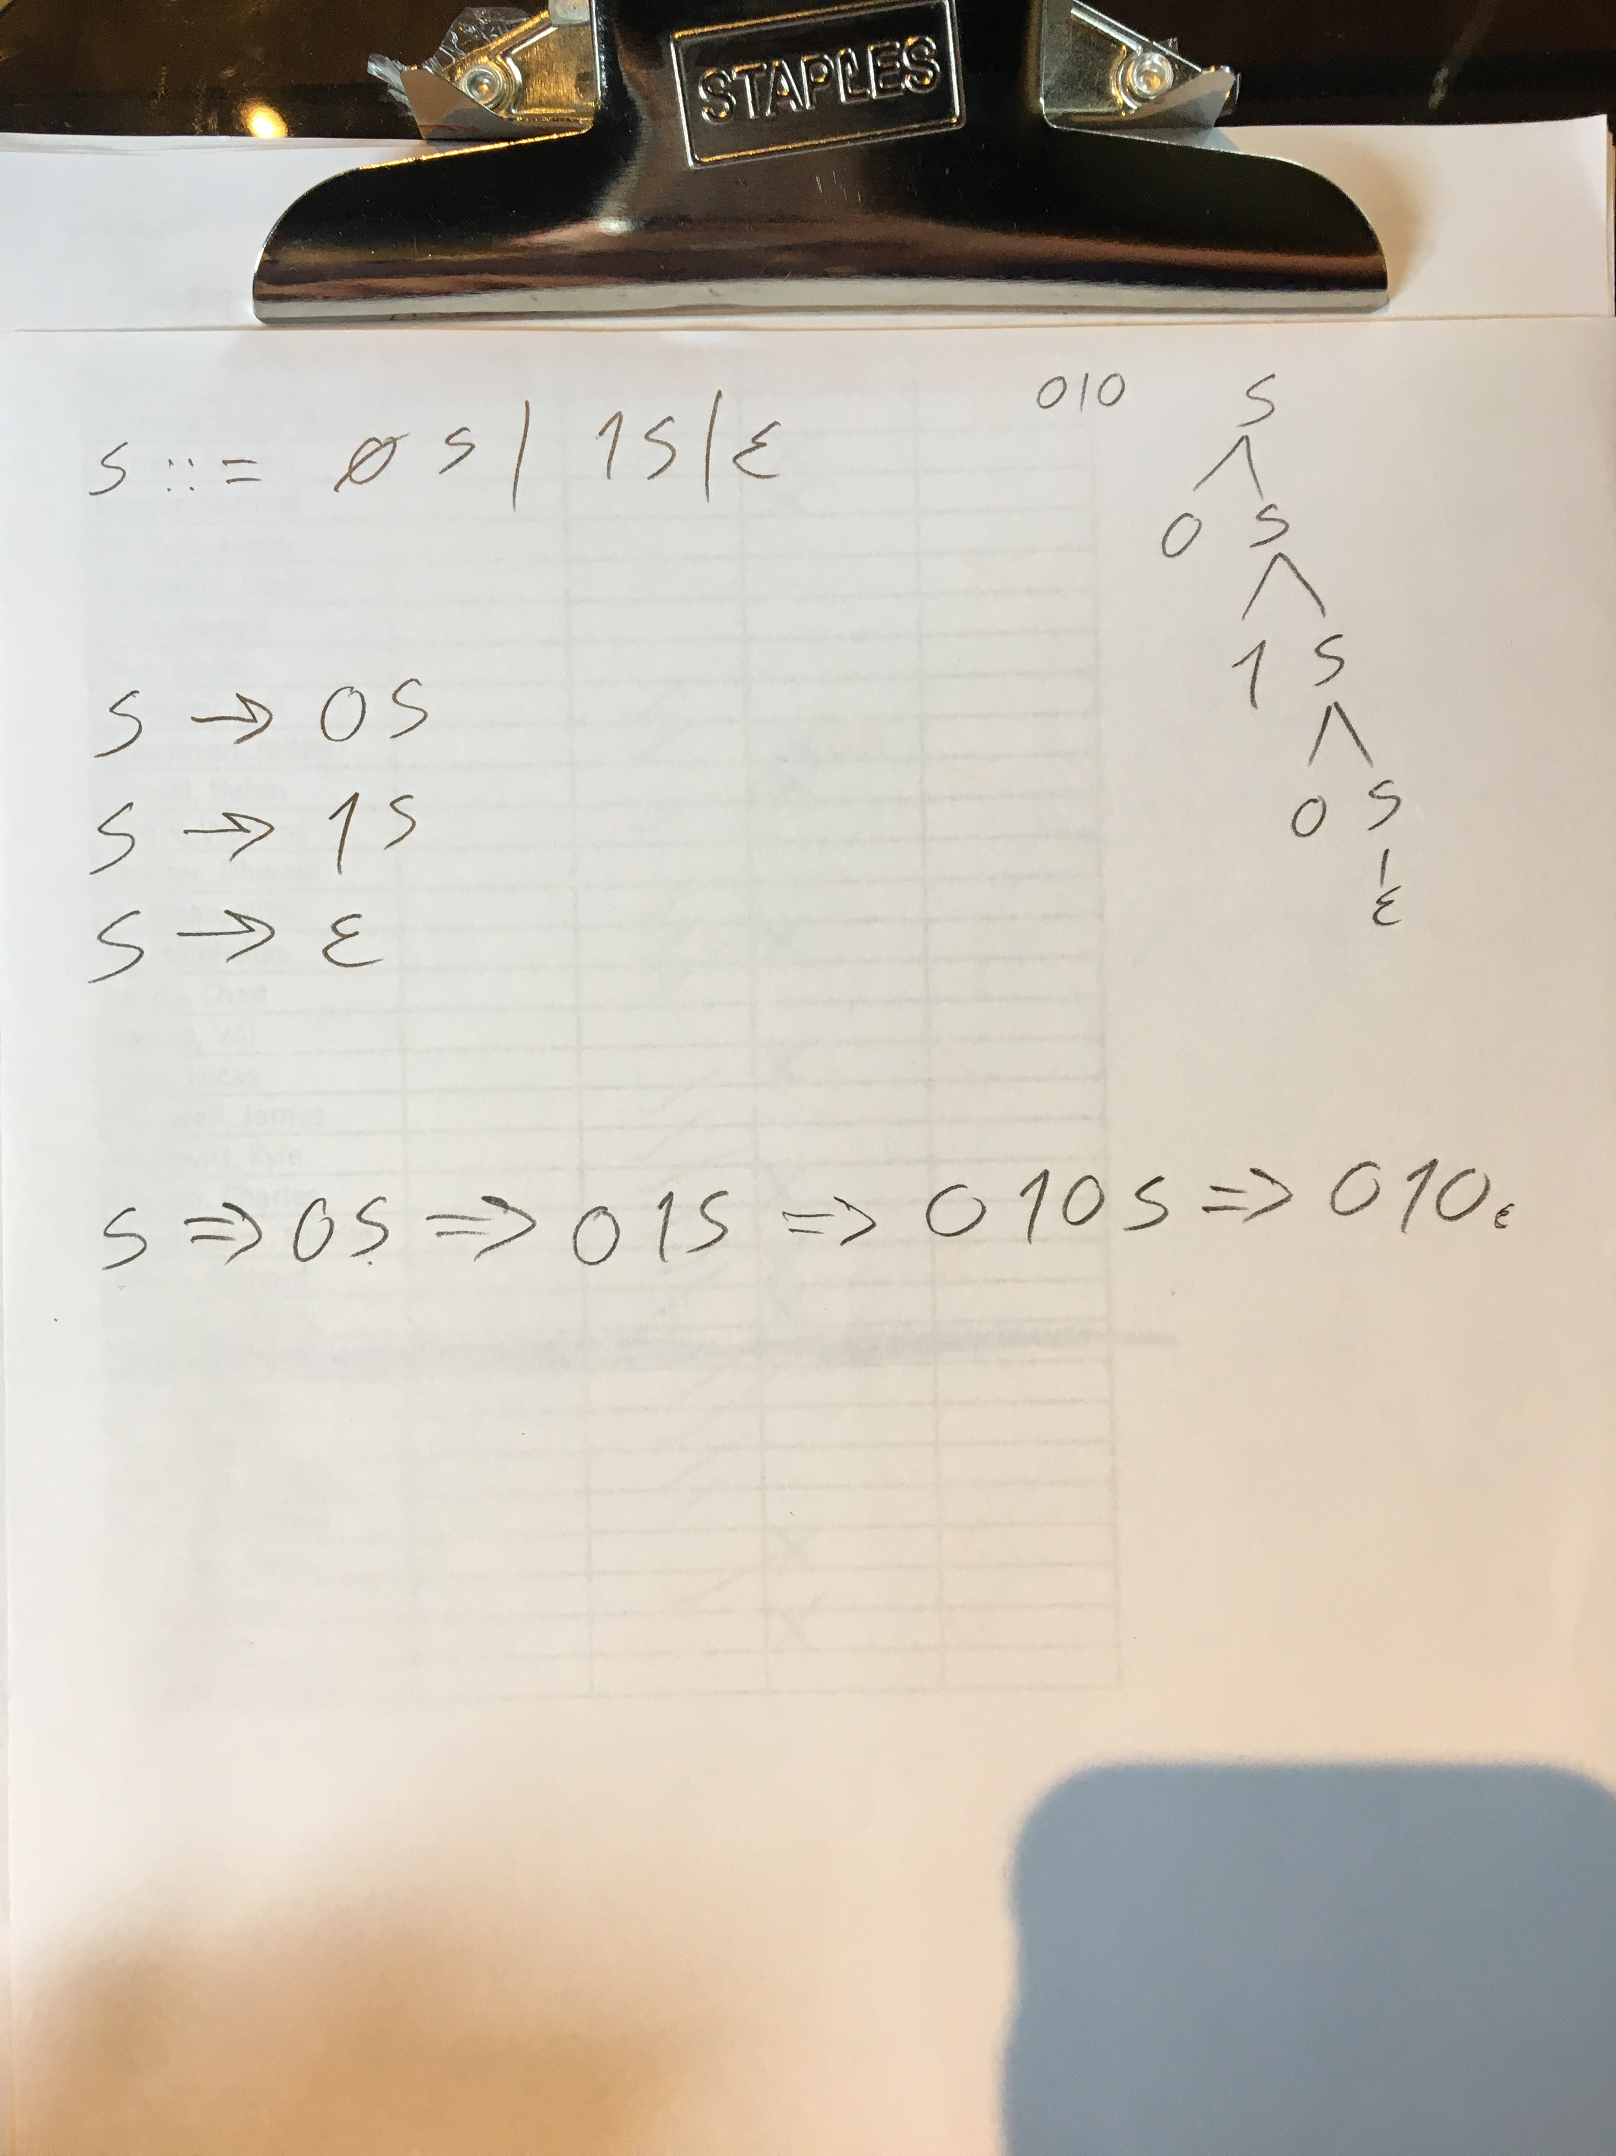

Slide 25
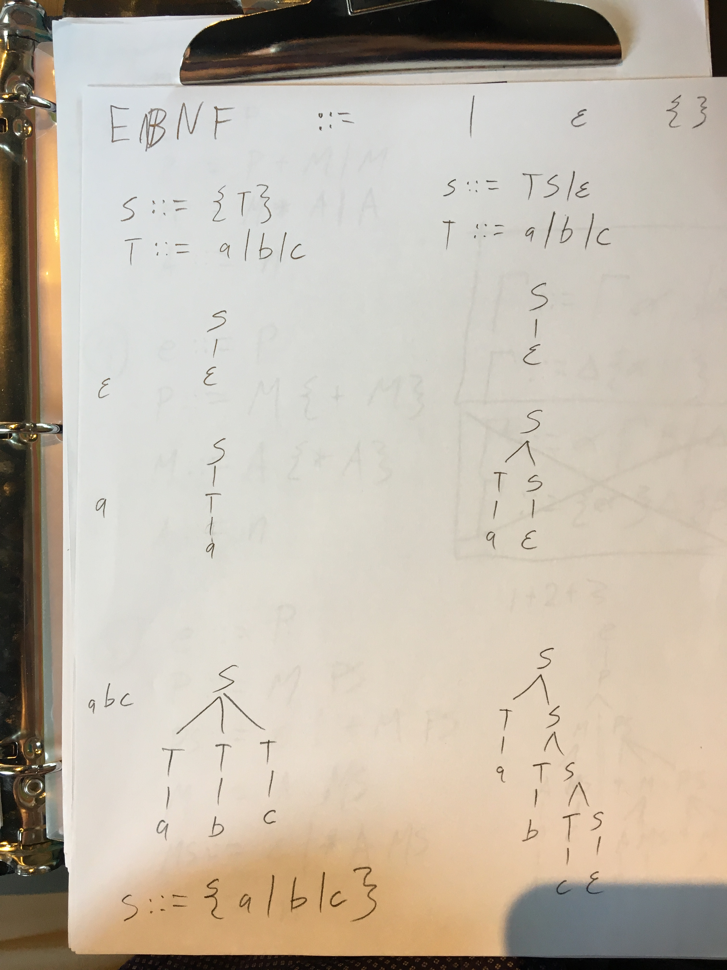

Slide 26
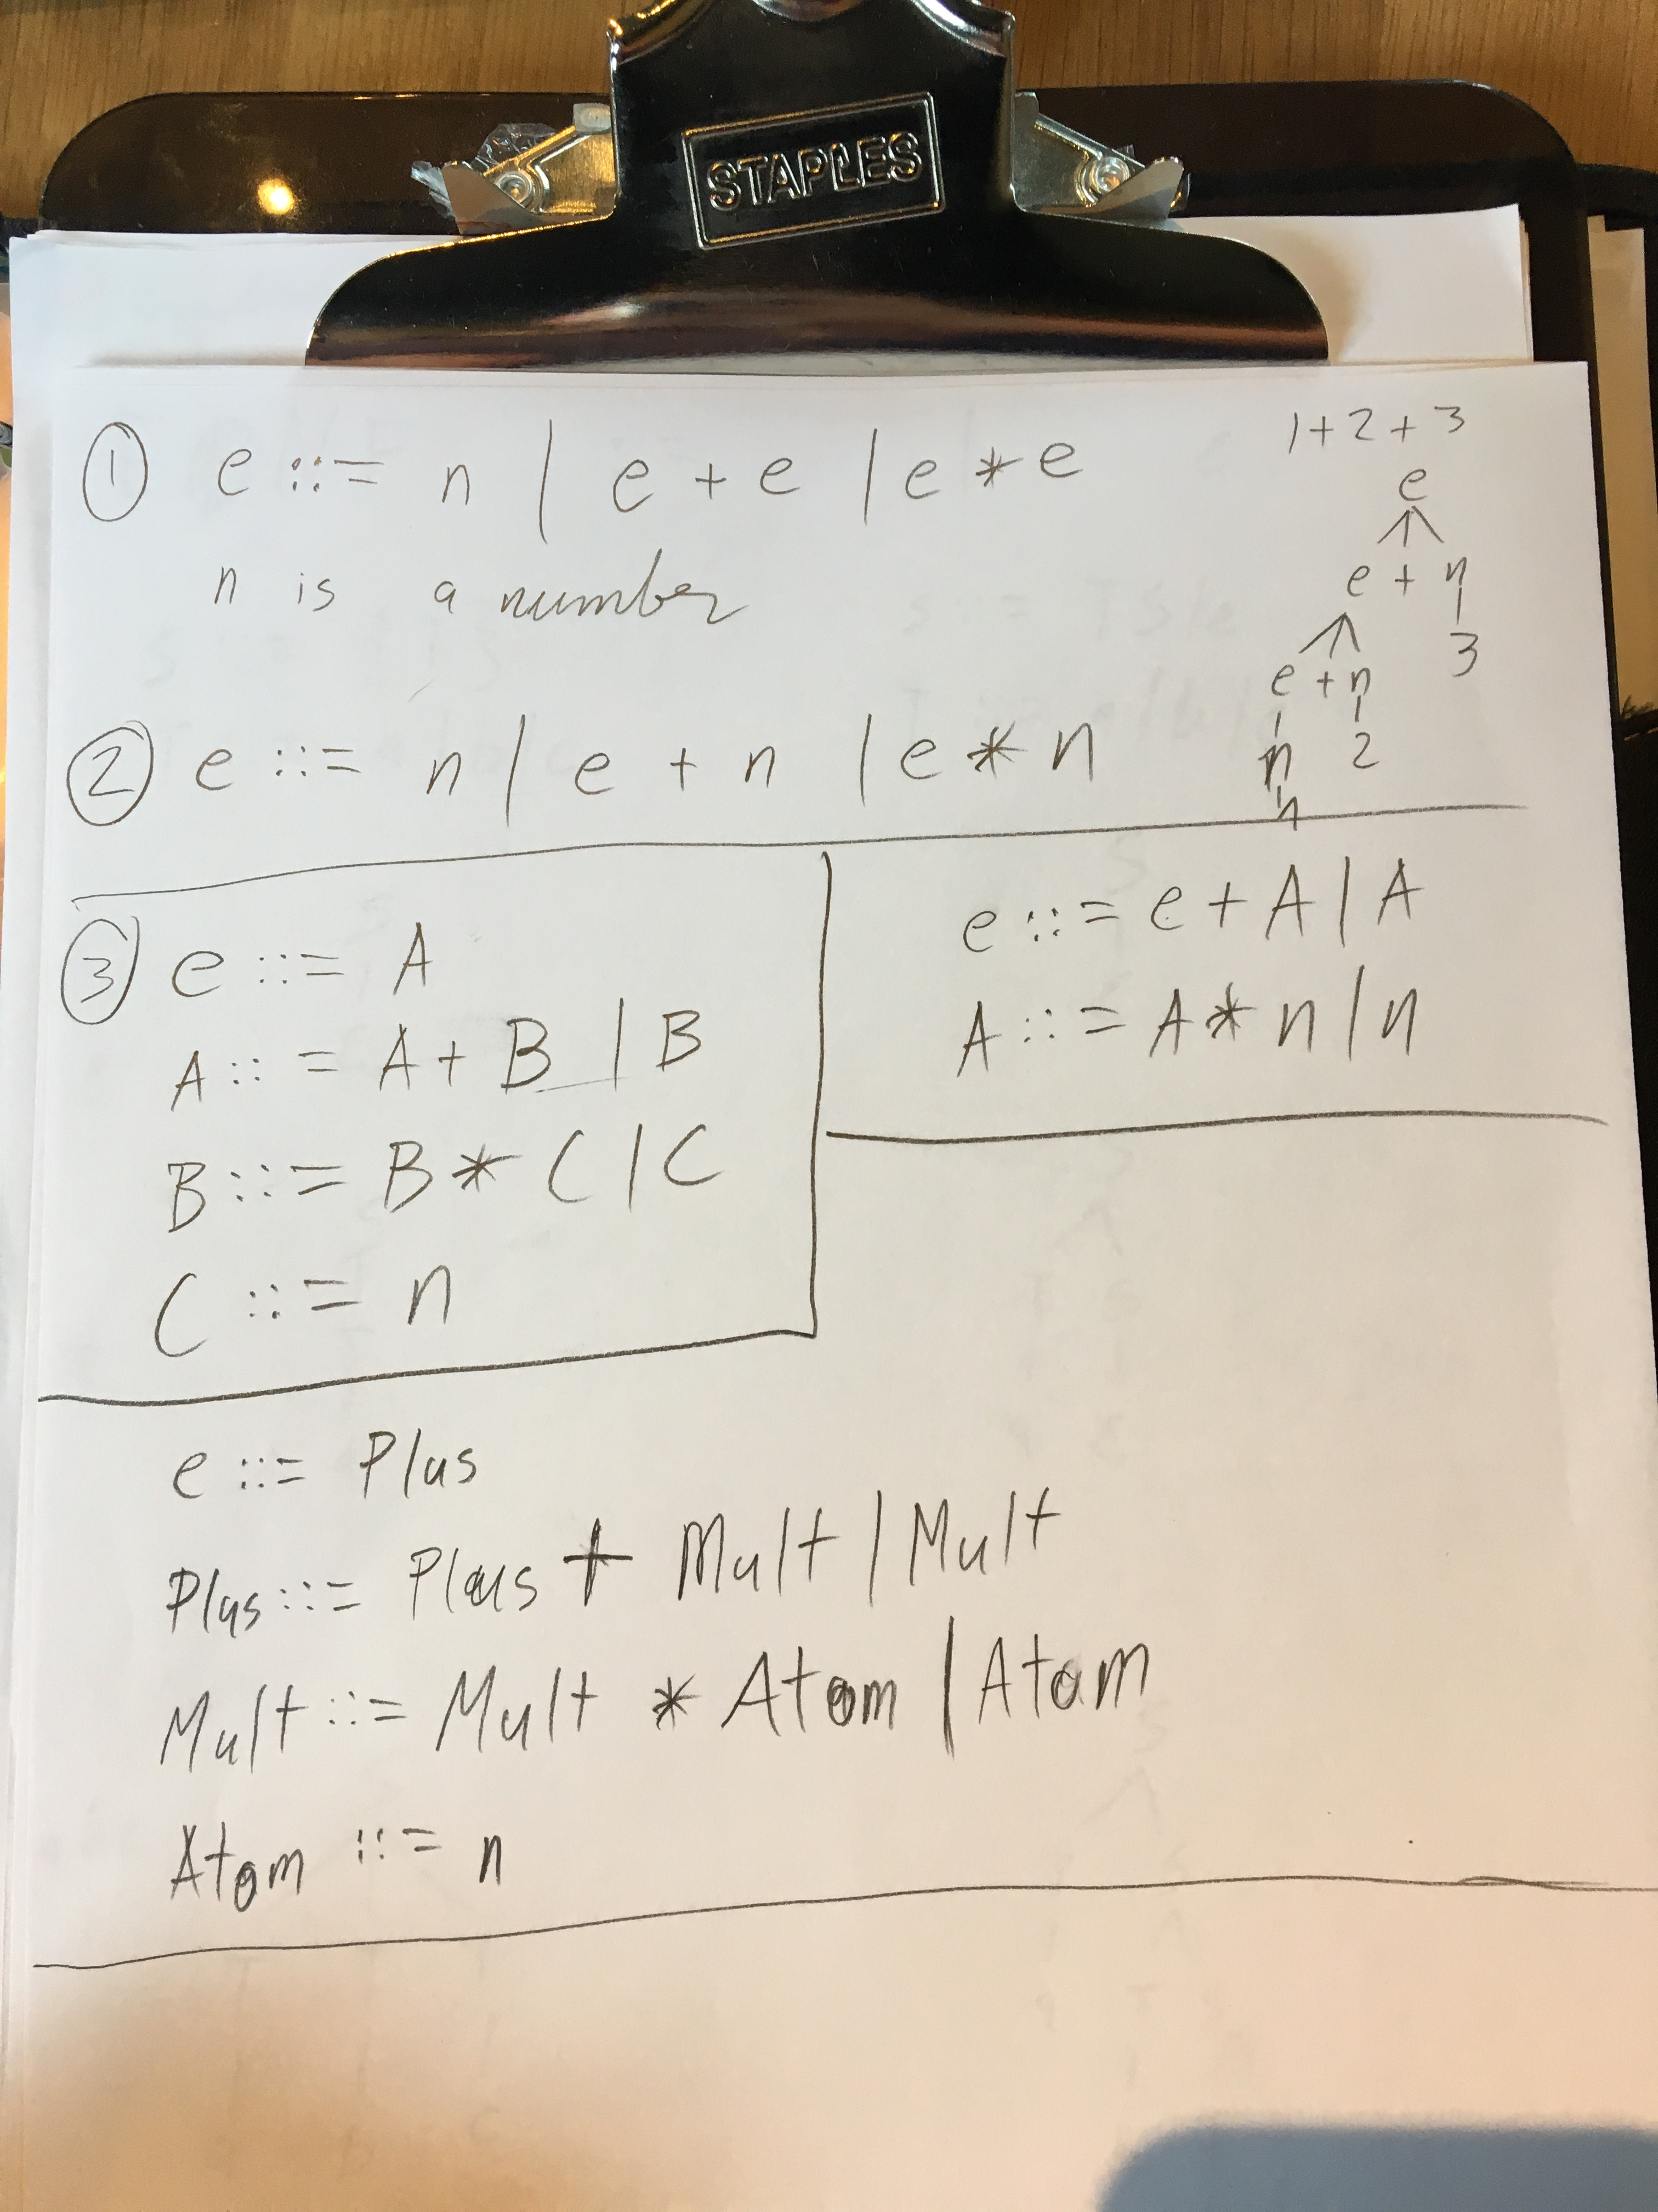
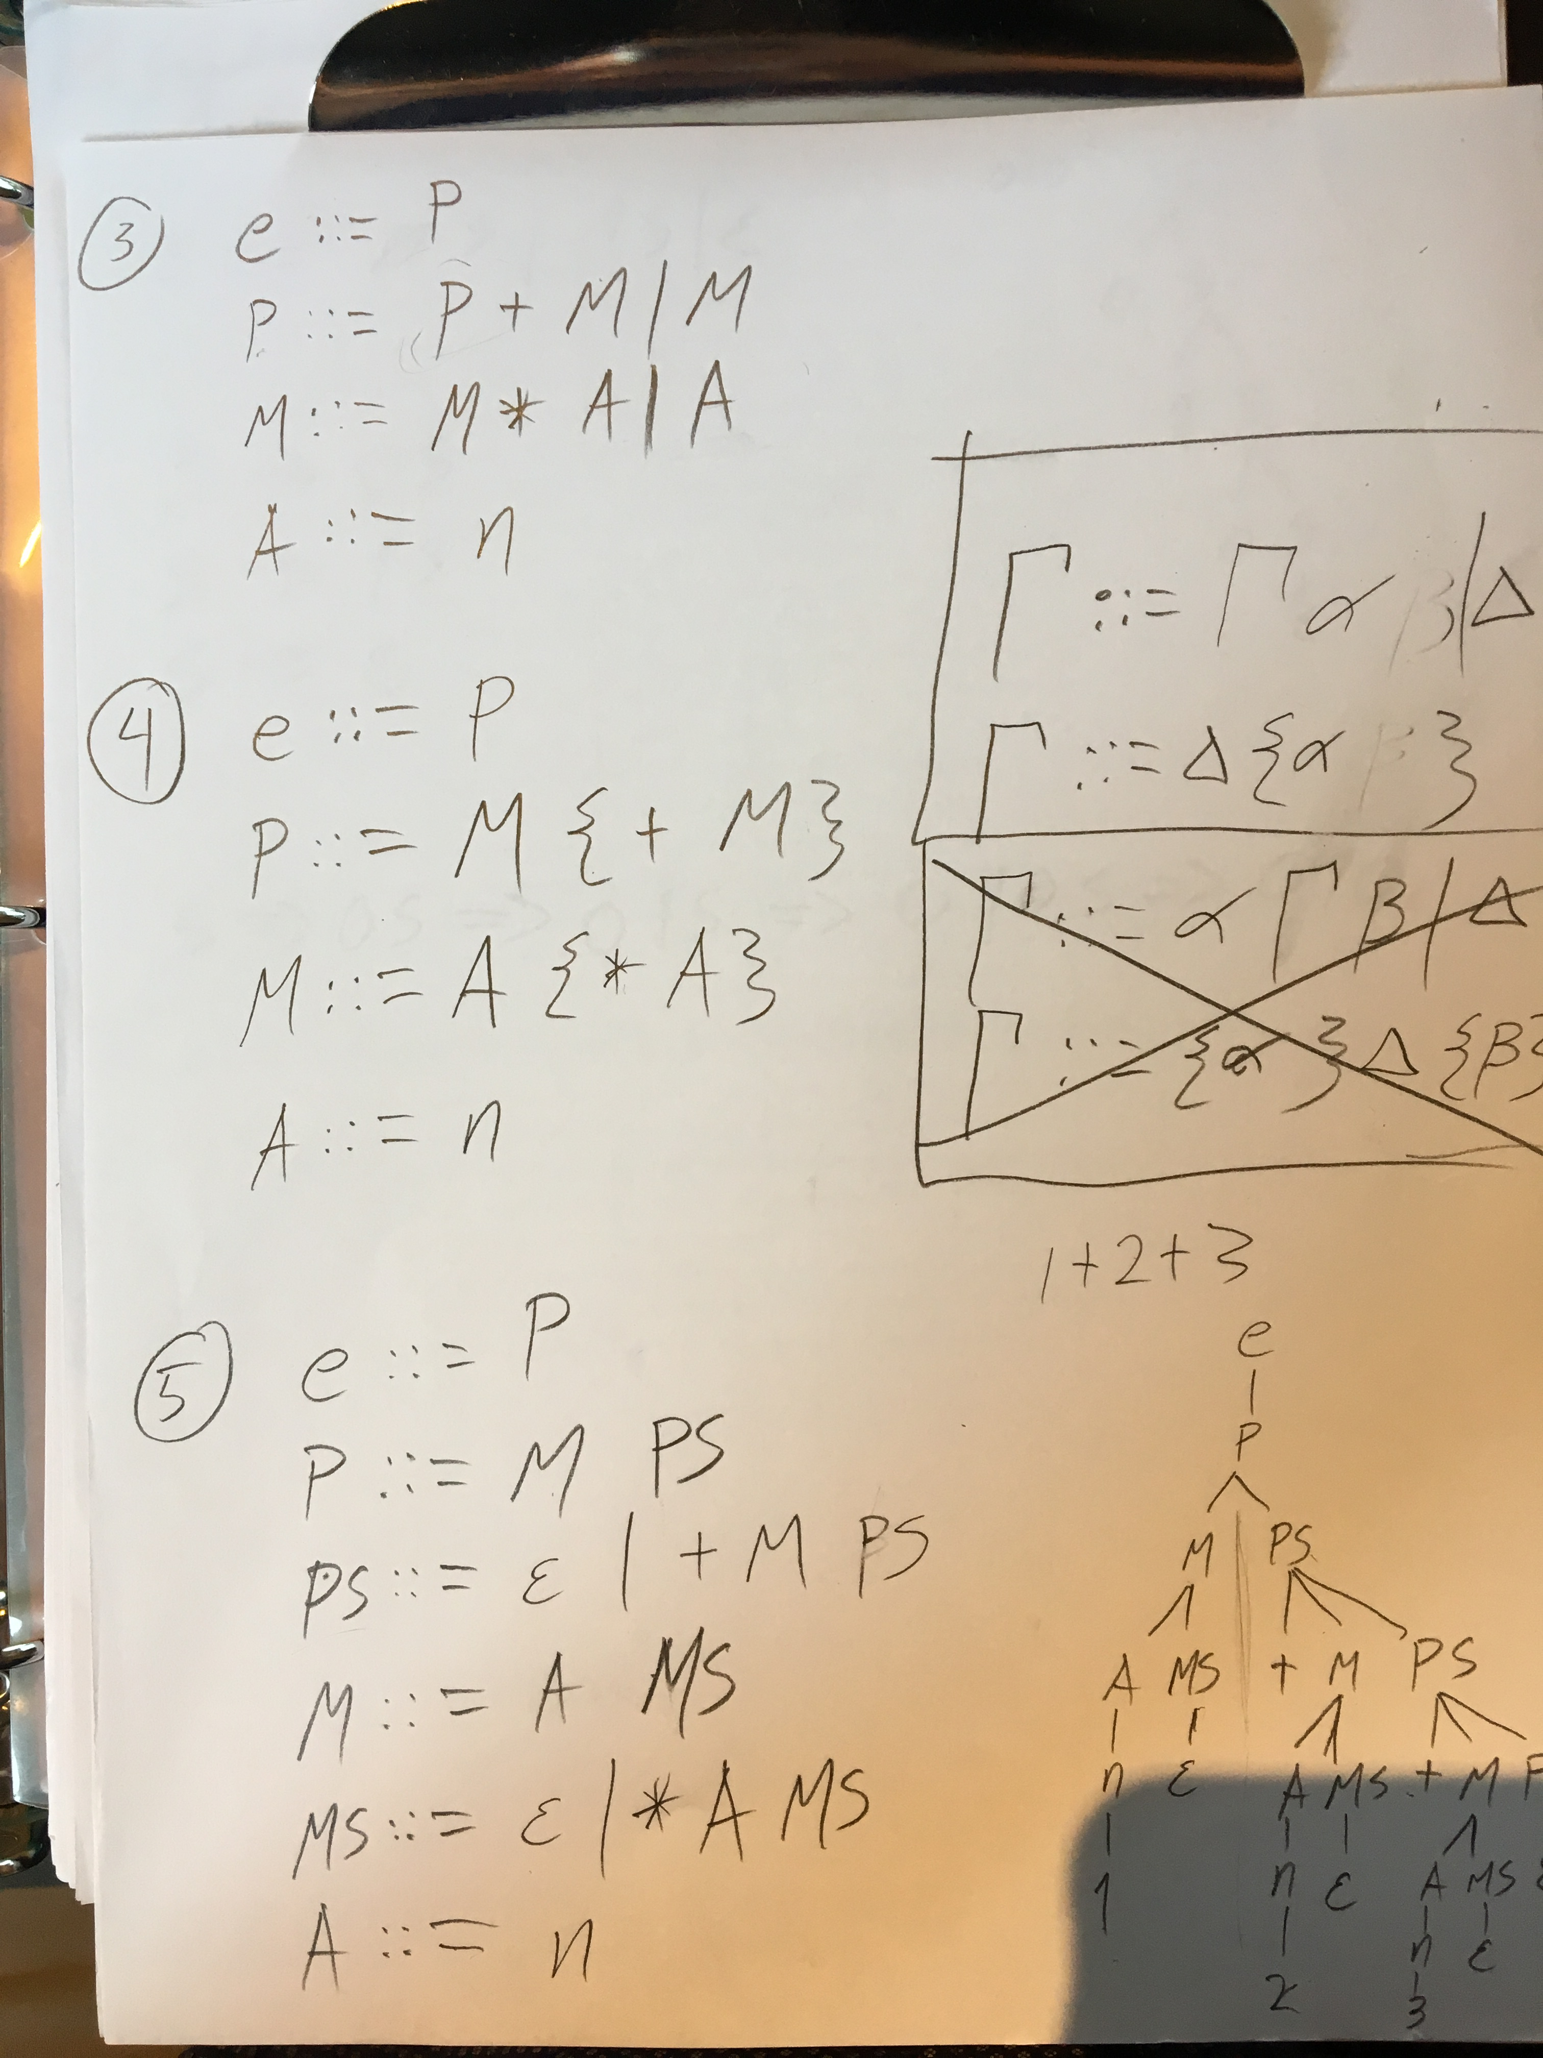

Slide 27
Questions?
?
Topic…

Slide 28
Lab 6

Slide 29
Regular expressions parser
In lab 6 you will create a parser for Regular Expression
i.e. you will write code which will take in strings over regular expressions and turn them into an AST that is representative of the provided Regular expression
Our AST is named RegExpr

Slide 30
Workflow
There is a logical order to implementing the parser and then implementing the comparison tester
BUT… Writing the parser first might prove very difficult, it’s more challenging
The only thing these have in common is the data structure (our AST, RegExpr). The parser creates the data structure
The comparison tester uses the data structure (our AST, RegExpr)

Slide 31
Workflow - recommendation
As soon as possible write the grammar for the RDP (described in the lab question 3.b.iv., this requires you first complete 3.b.i. and 3.b.iii.)
Consider your base cases
Then consider your inductive case

Slide 32
Workflow – recommendation
Write a test for the comparison thing `test`
Implement a solution, recall that here we are just implementing what the AST means, we don’t need to worry about how the AST is constructed
Write a test for the parser that parses the RegExp you used in the first part `re`
Implement a solution, recall that here we are just parsing and we don’t care what the AST means
Write an integration tests, or don’t… they shouldn’t really matter but they couldn’t hurt

Slide 33
Questions?
?
Lab 6

Slide 34
Questions?
?
Before class assignment

Slide 35
Lab 4 autograder
The lab 4 autograder is live
Do your best to get a high score
Due to the logistic issues and me getting this functioning so late in the game, I’ll likely give a push to you grade on the autograder

Slide 36
Lab 4 interview – scheduler is live…
Know the conceptual difference between call my name and call by value
Be able to recognize it’s use in Scala or JavaScripty
Be able to explain why this is useful
Know HOFs for List, Map and Option
Definitely know foldLeft and know how to use it
You might be able to solve the problems faster if you also know map, foldRight, exists
You might also benefit from know foreach, forall, and other HOFs
Provided a definition of an HOF on a data structure (even if it’s a Tree structure)
Be able to discuss how to use the HOF
Be able to make a reasonable attempt at using the HOF to solve a problem

Slide 37
ANNOUNCEMENTS
Lab 4 is due Sunday at the latest
Lab 4 interview scheduler is live, your interviews are next week
Lab 6 is live, I’ll be releasing everything you need ASAP, you have everything that you need for the time being.
Lab 6 is due at the end of next week
Lab 7 will be released next week, it will be a one week lab
After lab 7 is complete we will have a week to prepare for the final exam

Slide 38
L6D2 quiz
There was a bug
The quiz closed early
Sorry
I’ve extended it’s due date
It’s now due by tomorrow at 5:15 pm

Slide 39
Lab 7
Im still building lab 7
Im thinking
Monads
HOF
Testing
GitHub
Parallelism
Scala has a library of ??Promises??, knowing them might be useful for your career
It’s a useful skill that we don’t cover much here
See Scratch file

Slide 40
Extra credit
I’m altering the professionalism extra credit assignment
Something about networking
Meetup.com
Spark
Silicon flatiron
… others….

Slide 41
Questions?
?
Lab 6

